Slide 1
Lecture Foundations of Artificial Intelligence Part 10 – Machine Learning Clustering & Regression
Torsten Zesch
Language Technology Lab
Universität Duisburg-Essen

Slide 2
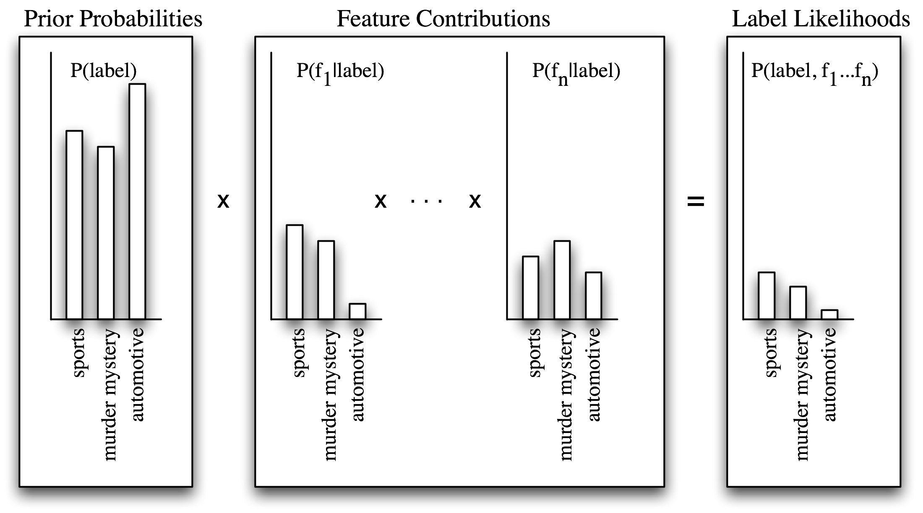
Last lecture: Naïve Bayes

Slide 3
Last lecture: Support vector machine
f(x,w,b) = sign(w x + b)
The maximum margin linear classifier is the linear classifier with the maximum margin.
This is the simplest kind of SVM (called LSVM)
Support Vectors are those datapoints that the margin pushes up against
Linear SVM

Slide 4



Last lecture: k-nearest neighbor
Different results of 3-nearest neighbor vs. 5-nearest neighbor search
=2 =3 →
Notes:
Cross-validation for finding good k’s

Slide 5
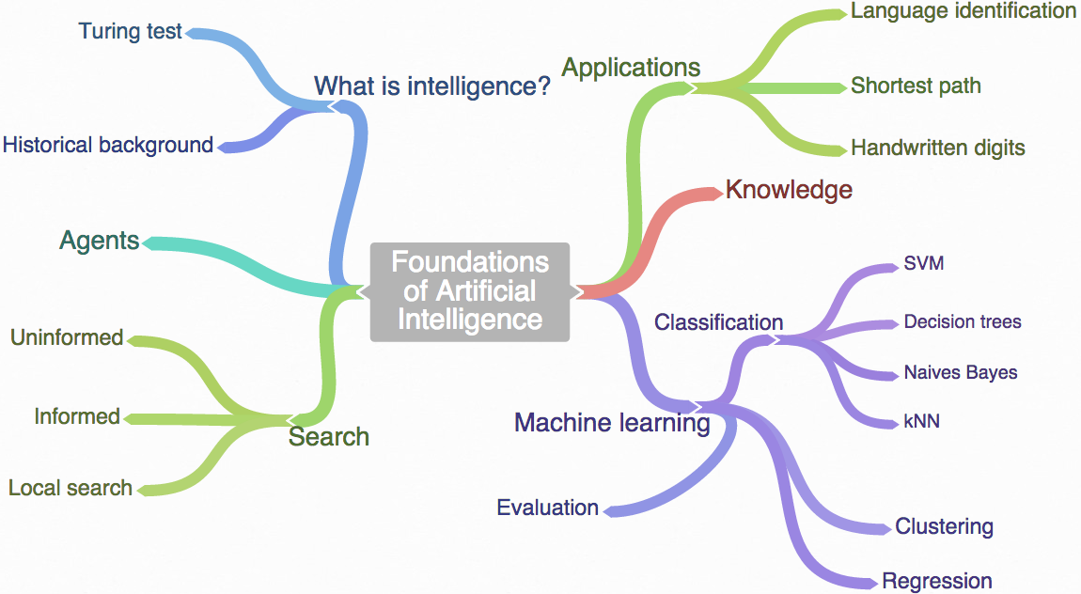
Course overview

Slide 6
Outline
Clustering
k-means Clustering
Graph Clustering
Reinforcement Learning
Notes:
6

Slide 7
Classification
Class1
Class2
Slides by Barbara Rosario

Slide 8
Classification
Class1
Class2
Slides by Barbara Rosario

Slide 9
Classification
Class1
Class2
Slides by Barbara Rosario
Notes:
Was zeigt der gelbe Kreis?

Slide 10
Classification
Class1
Class2
Slides by Barbara Rosario

Slide 11
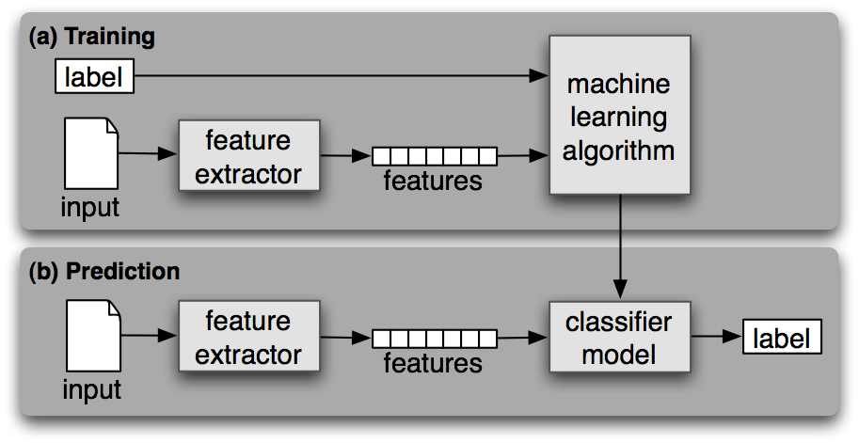
Supervised classification
A classifier is called supervised if it is built based on training corpora containing the correct label for each input.
Supervised classification framework

Slide 12
Clustering
Slides by Barbara Rosario

Slide 13
Clustering
Slides by Barbara Rosario

Slide 14
Clustering
Slides by Barbara Rosario

Slide 15
Clustering
Slides by Barbara Rosario

Slide 16
Clustering
Slides by Barbara Rosario

Slide 17
Unsupervised classification
A classifier is called unsupervised if no training corpora containing the correct label for each input is used.
Supervised classification framework
Cluster
Model
Cluster
Assignment

Slide 18
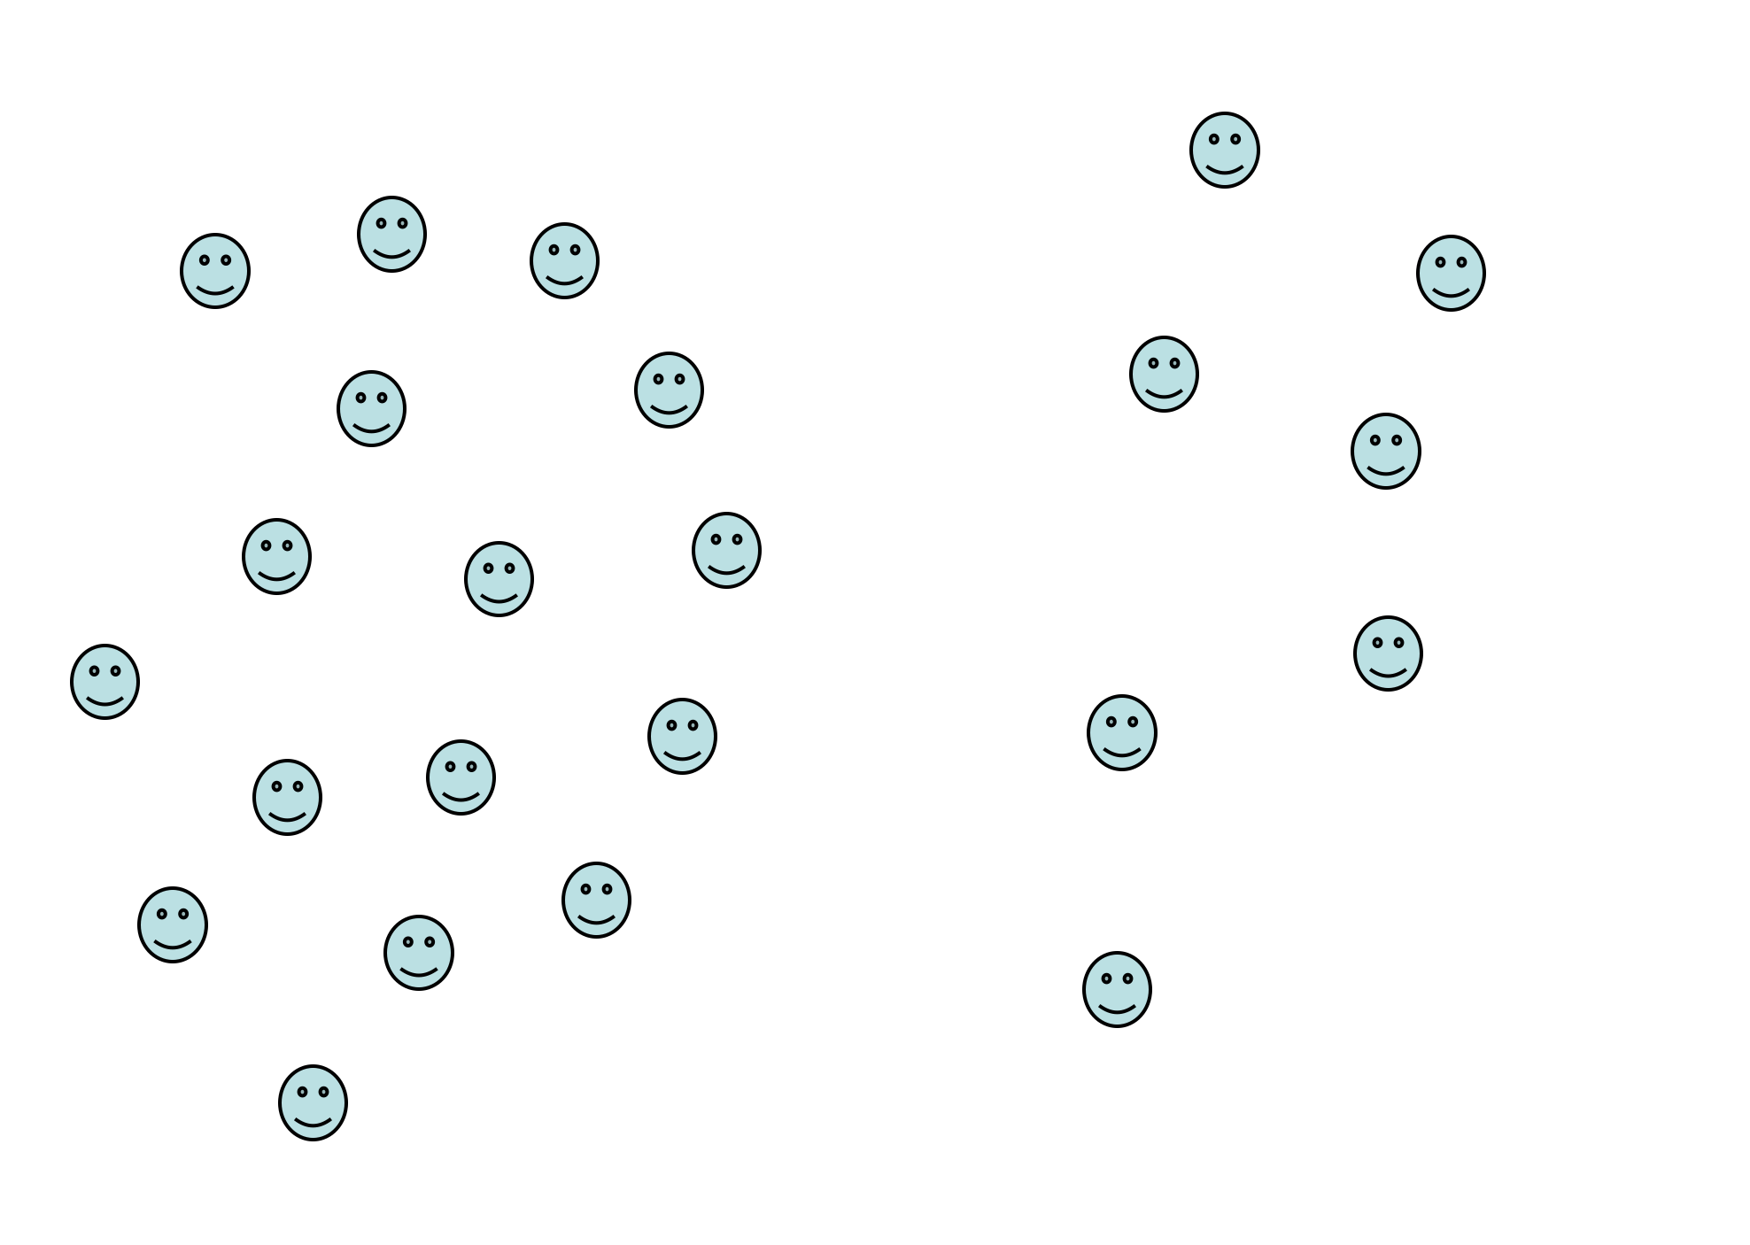
What is clustering?
Form of unsupervised learning
i.e. we do not know the classes
no training data, only data
Goal: group input instances into classes of similar objects
low inter-class similarity
high intra-class similarity

Slide 19
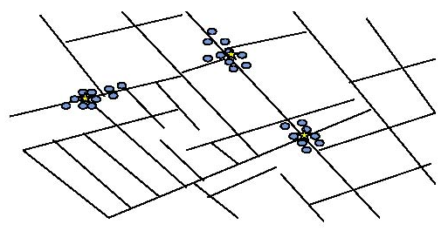
Early application of clustering
John Snow, a London physician, plotted the locations of cholera deaths on a map during an outbreak in the 1850s
Deaths clustered around certain polluted wells
from Nina Mishra HP Labs
Notes:
wir entdecken Muster, die soweiso da sind

Slide 20
Applications of clustering: Astronomy
SkyCat clustered sky objects into stars, galaxies, quasars, etc. based on radiation emitted in different spectrum bands
from Nina Mishra HP Labs
Notes:
Niemand weiß, was ein Quasar ist, aber es gibt vieles was irgendwie ähnlich ist...

Slide 21
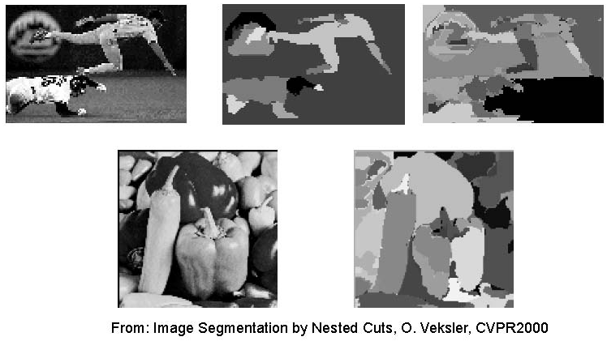
Applications of clustering: Image segmentation
Find interesting “objects” in images to focus attention on

Slide 22
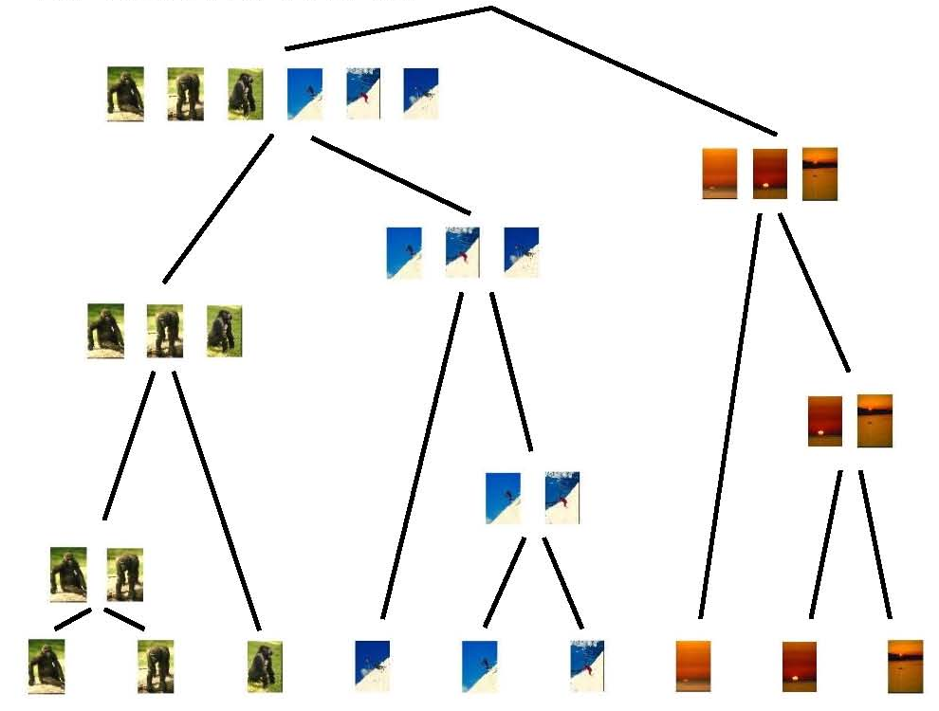
Applications of clustering: Data organization
Store database records according to clusters for efficient retrieval

Slide 23
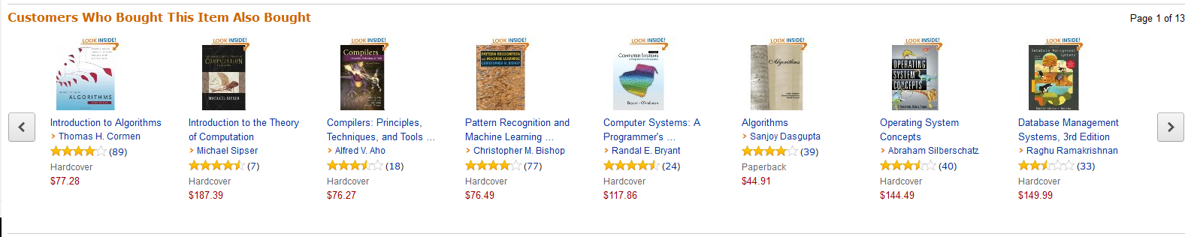
Applications of clustering: Customer groups
Online shops cluster customers based on shopping behavior

Slide 24
Clustering
Process of organizing objects into groups whose members are similar
objects within a cluster should be more similar to each other than to objects in a different cluster
clustering needs a similarity function, defined over features
Clustering is unsupervised
there is no target classification
finds the ‘natural’ order of things
There is a very wide variety of clustering algorithms:
k-means: popular, simple, quick
graph clustering methods

Slide 25
Kinds of clustering
Partitioning / hard clustering / exclusive clustering
every object belongs to exactly one cluster
simple and flat, but the world is sometimes not that easy
Soft clustering / overlapping clustering
every object belongs to at least one cluster
still flat, but accounts for in-between objects
Hierarchical clustering
clusters are contained in each other
adds a lot of structure
when to stop / what granularity to consider?
Probabilistic clustering
each object gets assigned a distribution over clusters
very expressive
usually expensive to compute

Slide 26
Outline
Clustering
k-means clustering
Graph clustering
Reinforcement Learning
Notes:
26

Slide 27
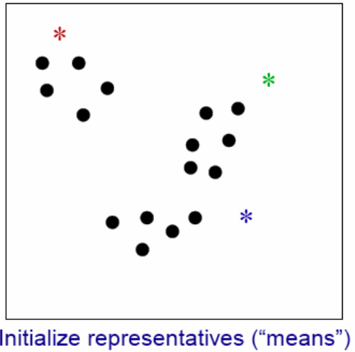
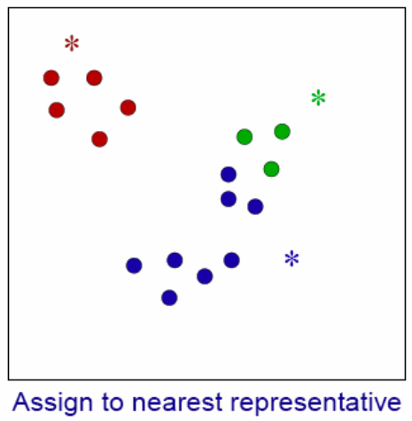
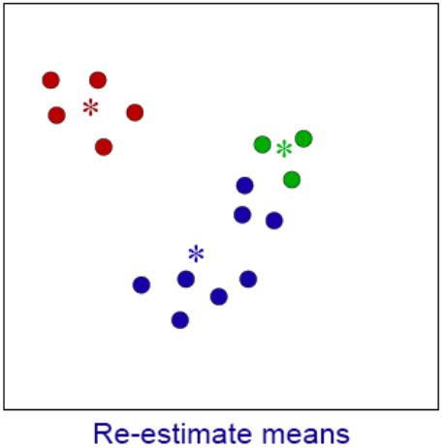
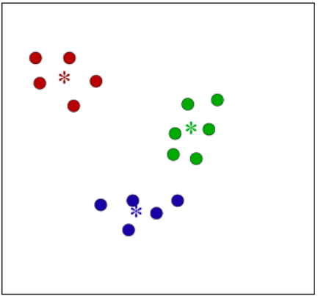
K-means example
Convergence: cluster assignments do not change
Complexity: O(n) with
k number of clusters
n number of objects
i number of iterations
n >> k AND n >> i
convergence

Slide 28
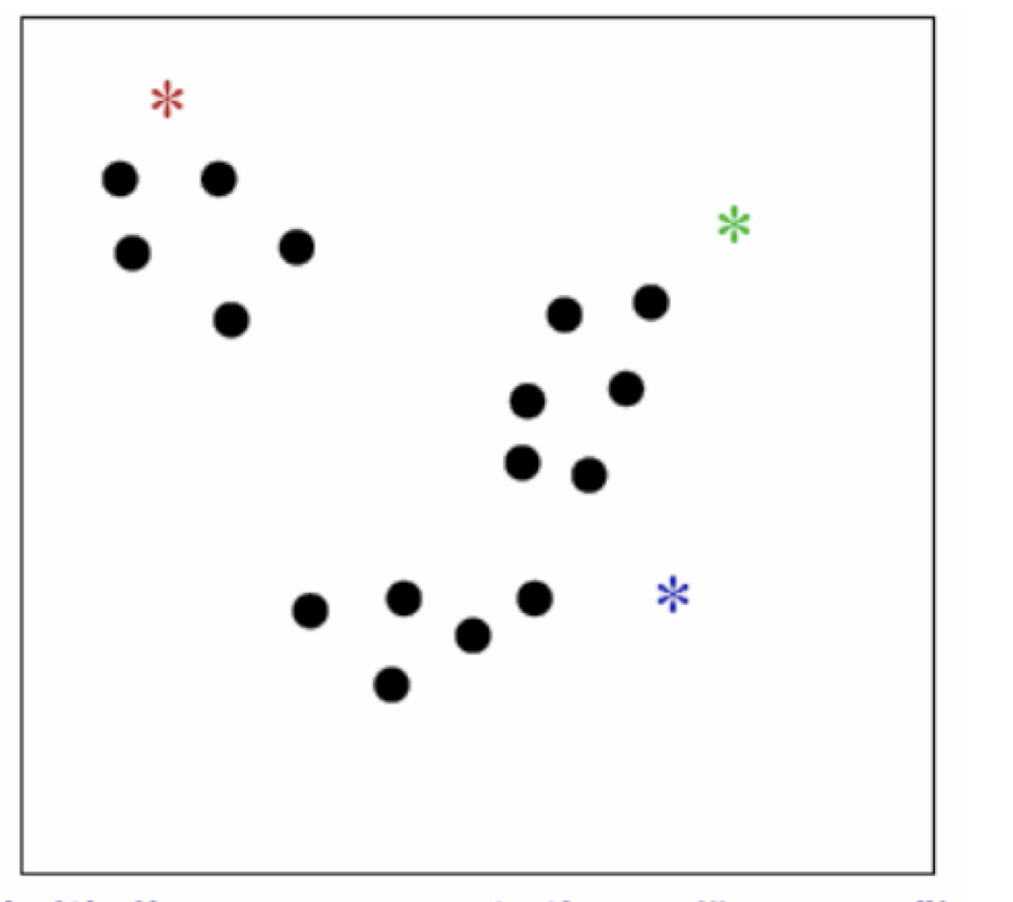
K-means clustering
Input: feature vectors of objects
Input parameter: k = number of clusters
Required: similarity/distance function
Algorithm:
choose k random points as initial centroids
repeat until convergence
assign each object to its closest centroid: k clusters
compute new centroid per cluster: average point

Slide 29
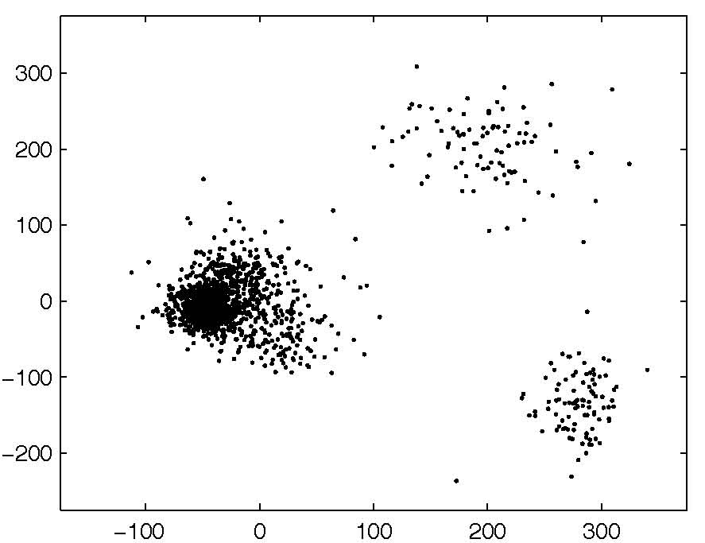
k-means example

Slide 30
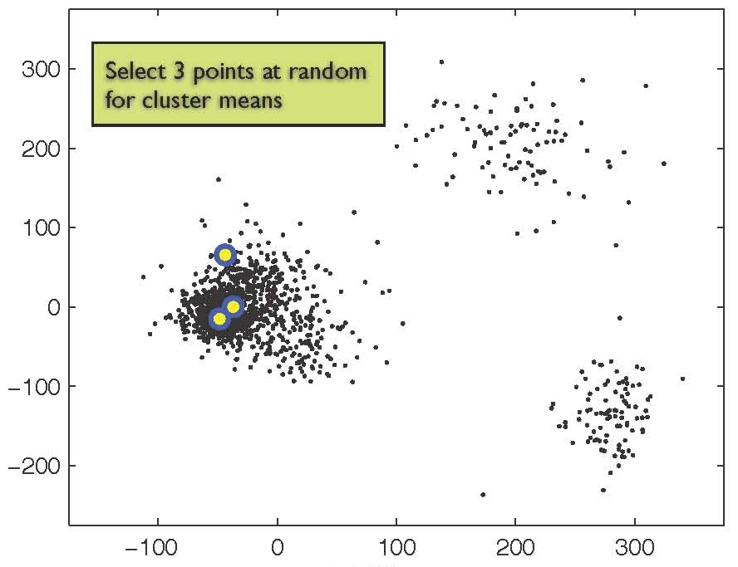
k-means example
Select three points at random for cluster means

Slide 31
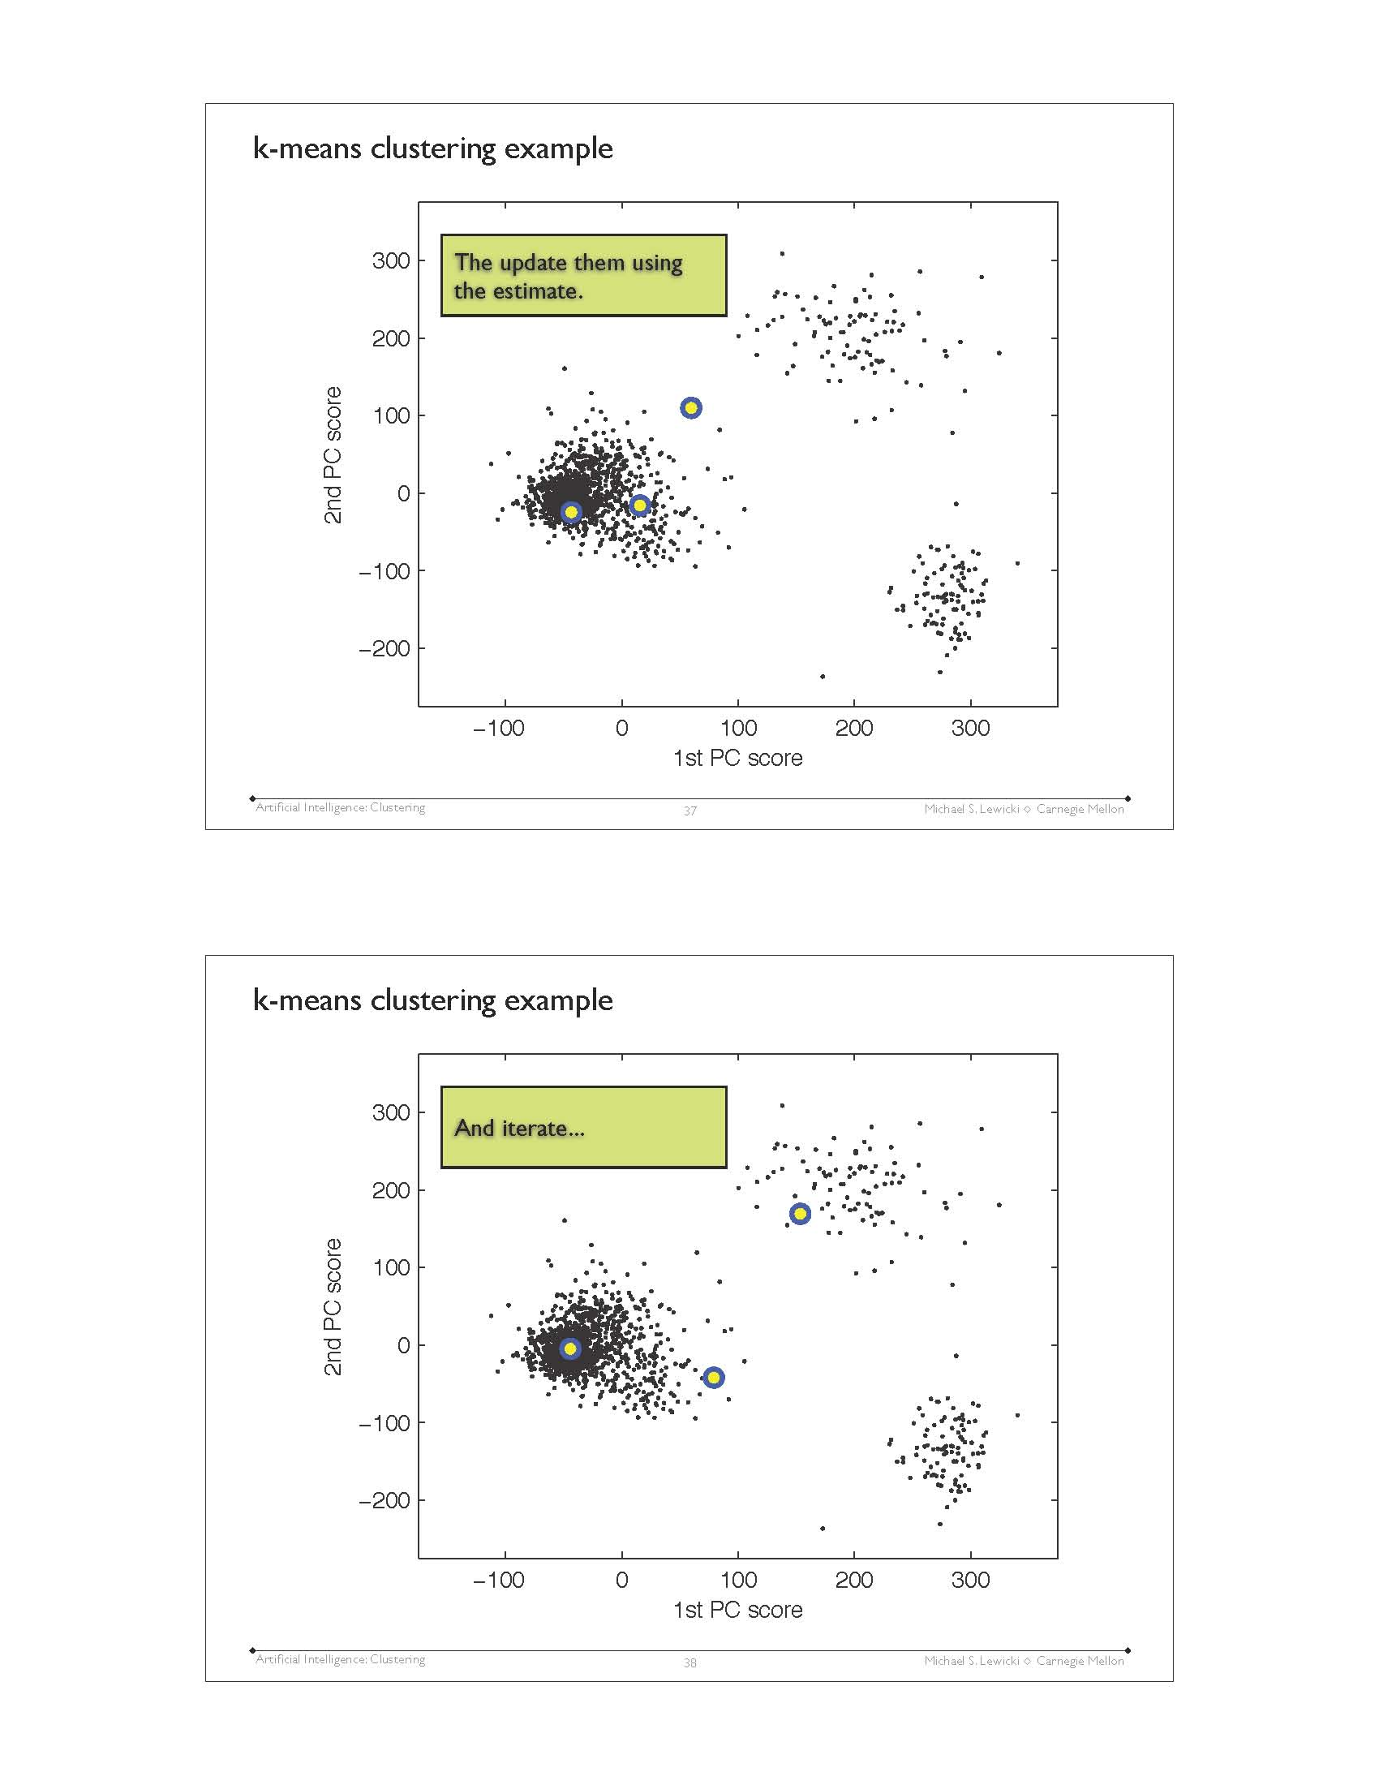
k-means example
Then update them using the estimate

Slide 32
k-means example
and iterate …

Slide 33
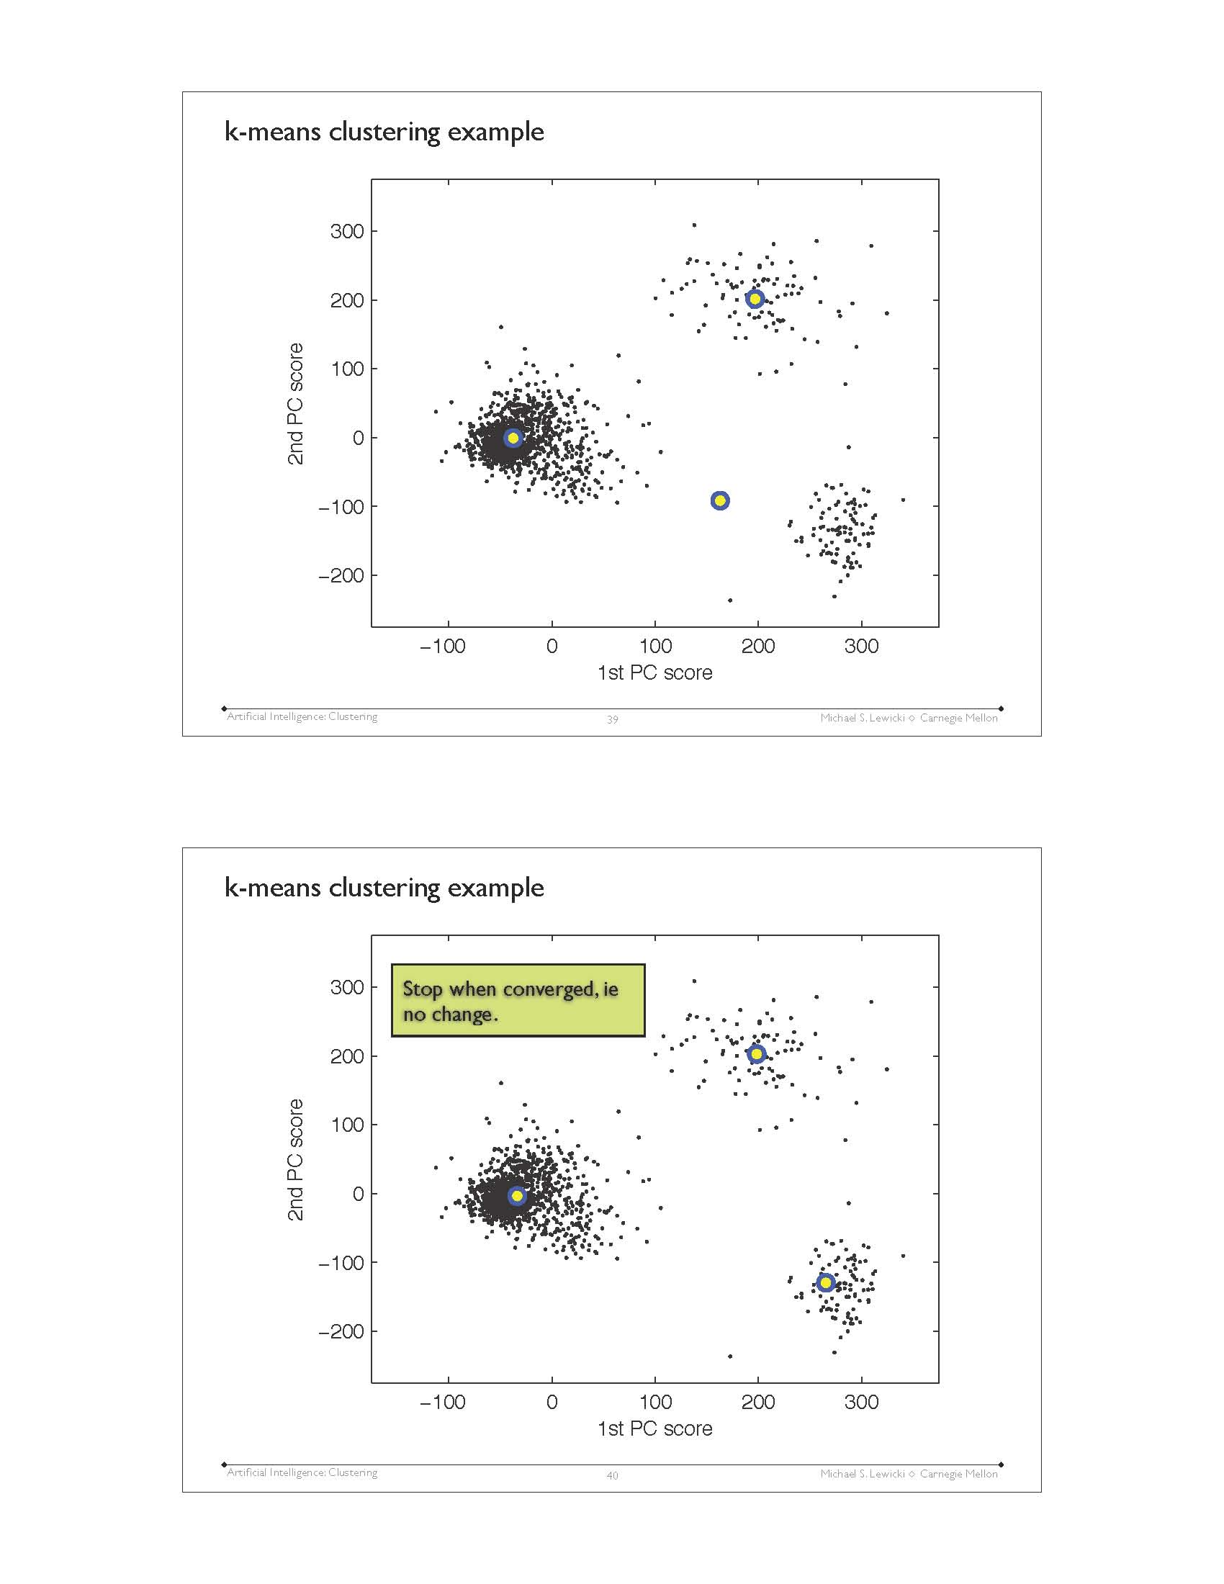
k-means example

Slide 34
k-means example
Stop when converged,
i.e. no change

Slide 35
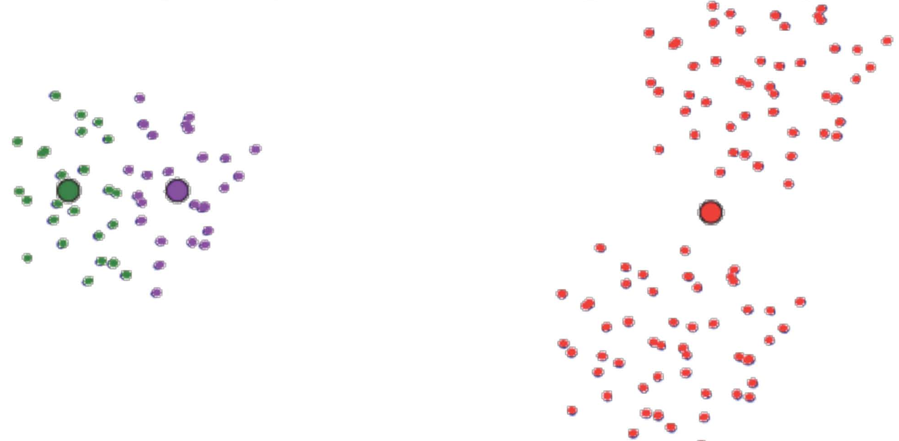
Local minima
To avoid: repeat k-means from many different random starting positions

Slide 36
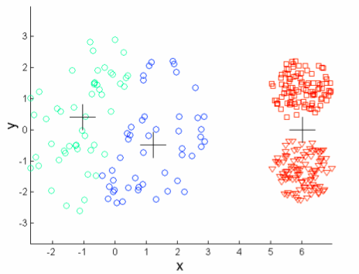
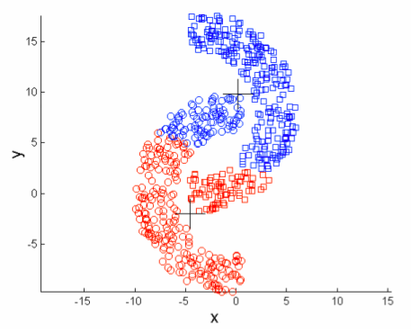
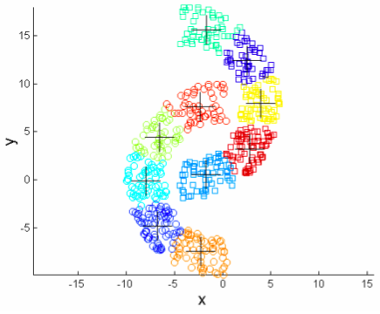
Benefits and drawbacks of k-means
Advantages
quick
intuitive
gives often good results
Disadvantages
how to set k?
applicable only on data with geometric interpretation
sensitive to outliers and noise
not suitable to discover clusters with non-convex shapes / with different densities

Slide 37
How do we evaluate the clusters?
In the common application case: evaluation is difficult.
We do not know the best clusters.
If we knew, we would not need to apply clustering.
We can evaluate intra- and inter-cluster similarity
By inspection: does the clustering show us something useful?
In the theoretical case: compare to a set of gold clusters
→ useful for comparing the properties of different clustering algorithms

Slide 38
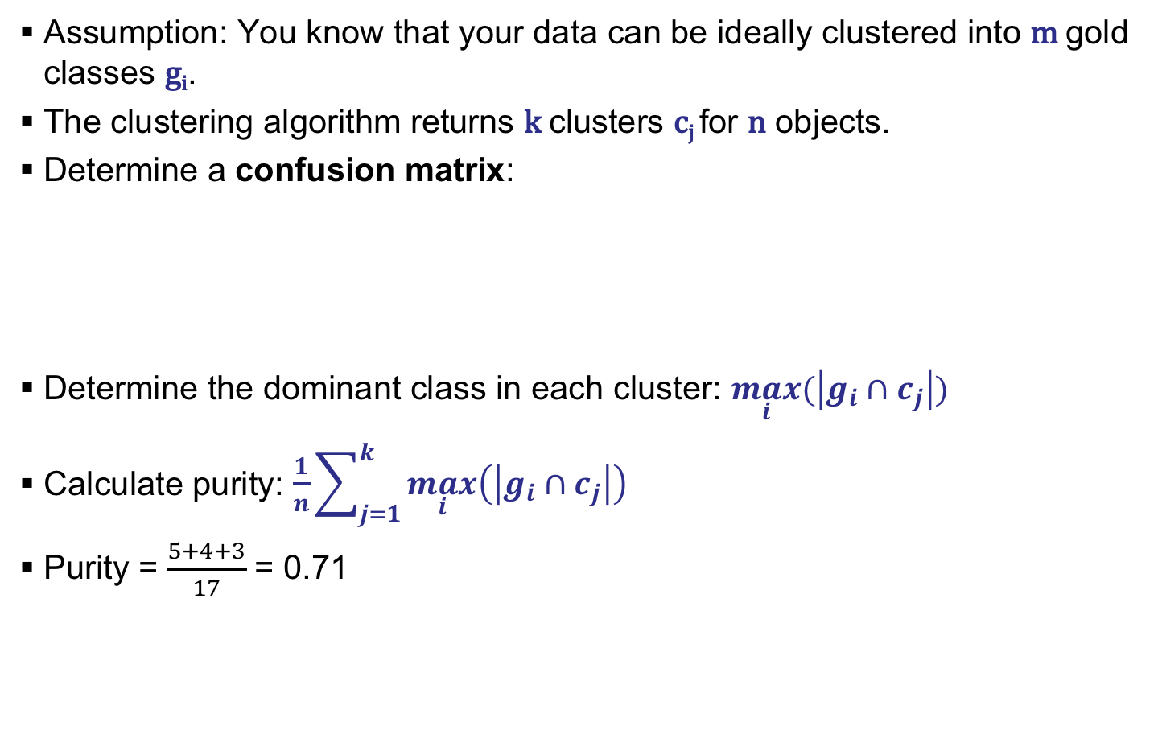
Purity
Assumption: You know that your data can be ideally clustered into m gold classes g_{i}.
The clustering algorithm returns k clusters c_{j} for n objects.
Determine a confusion matrix:
Determine the dominant class in each cluster: $\max_{i}{(\left|g_{i}∩c_{j}\right|)}$
Calculate purity: $\begin{aligned}\frac{1}{n}\sum_{j=1}^{k}{\max_{i}\left(\left|g_{i}∩c_{j}\right|\right)}{ }\end{aligned}$
Purity = $\frac{5+4+3}{17}$ = 0.71
 | g₁ | g₂ | g₃
c₁ | 5 | 1 | 0
c₂ | 1 | 4 | 1
c₃ | 2 | 0 | 3
Notes:
Purity ist nur ein mögliches Maß

Slide 39
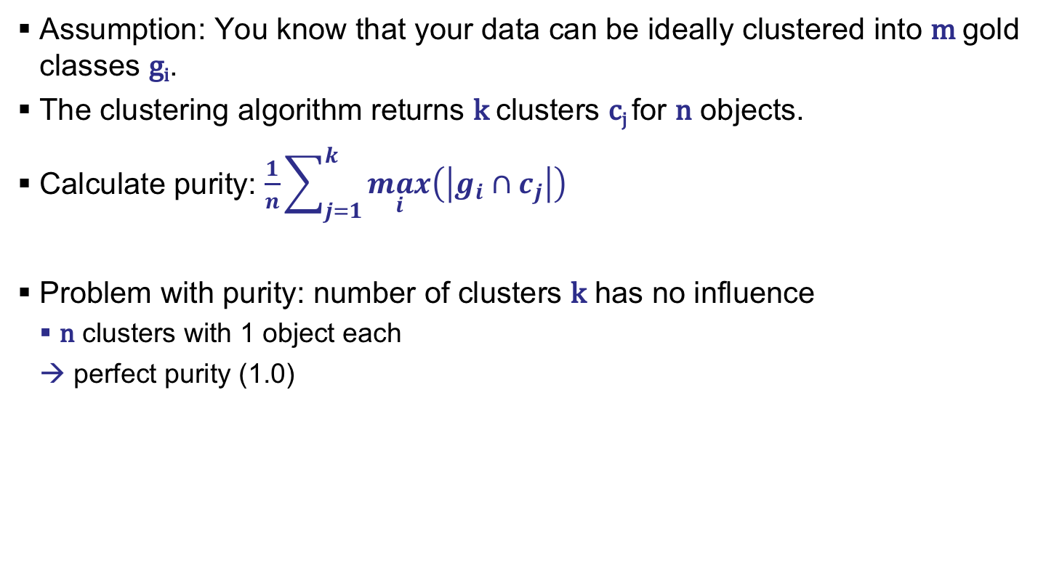
Purity
Assumption: You know that your data can be ideally clustered into m gold classes g_{i}.
The clustering algorithm returns k clusters c_{j} for n objects.
Calculate purity: $\begin{aligned}\frac{1}{n}\sum_{j=1}^{k}{\max_{i}\left(\left|g_{i}∩c_{j}\right|\right)}{ }\end{aligned}$
Problem with purity: number of clusters k has no influence
n clusters with 1 object each
→ perfect purity (1.0)

Slide 40
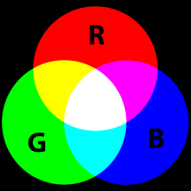
Example: Image compression
Number of colors determines (among other factors) image size
Compression
replace similar colors with a shared color
How to select the colors that remain in the image?
each color is represented by its RGB value
can be mapped to 3-dimensional space
within that space, similarity of colors can be computed
Assumption
clusters will contain similar colors

Slide 41
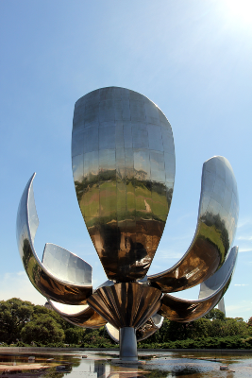
Source image

Slide 42
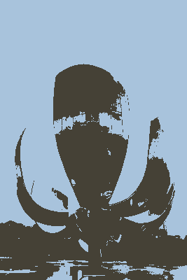
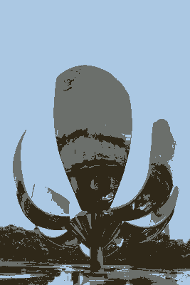
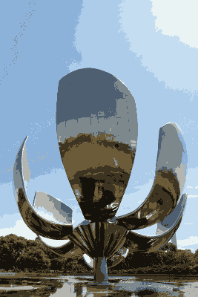
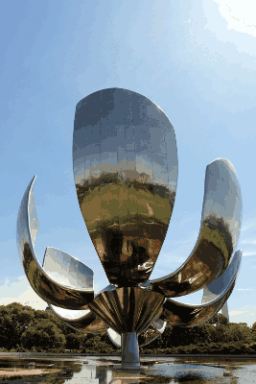

Clustering Results
k=2
s=4 [kb]
k=3
s=6 [kb]
k=10
s=14 [kb]
k=50
s=33 [kb]
k=100
s=46 [kb]
k=55000
s=170 [kb]

Slide 43
Some Details
original
k=100
k=5

Slide 44
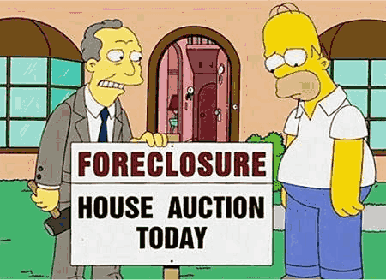
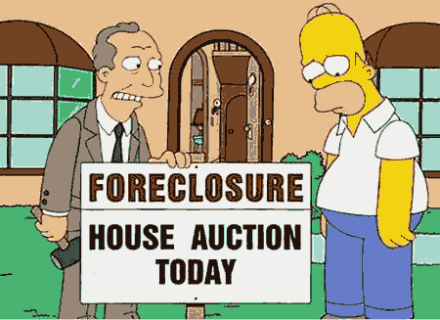
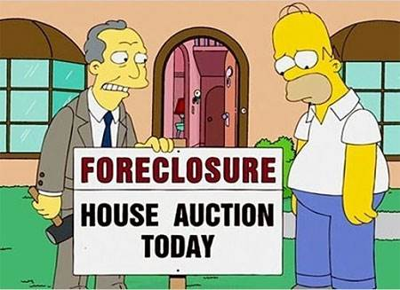
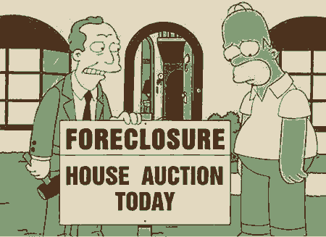
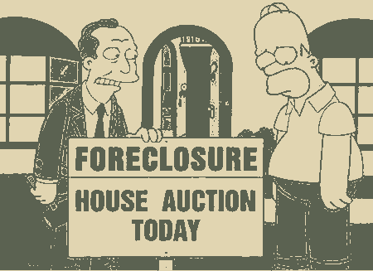
Clustering Results
k=50
k=10
original
k=3
k=2

Slide 45
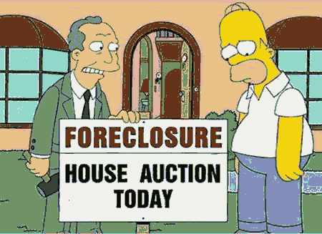
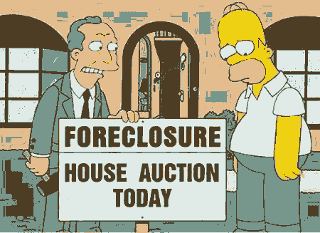
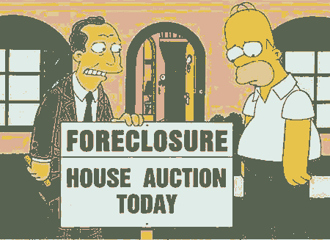
Clustering vs. Random Selection
clustered
random
k=10
k=5
Notes:
also random is not totally bad – high probability to select a sensible color

Slide 46

Clusters in real life
If you do your exercises, you’ll be good in the exam!

Slide 47
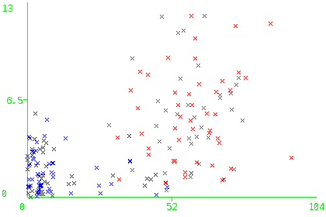
Clusters: Bonus and exam points (k=2)
Bonus points
Points in exam

Slide 48
Outline
Clustering
k-means clustering
Graph clustering
Reinforcement Learning
Notes:
48

Slide 49
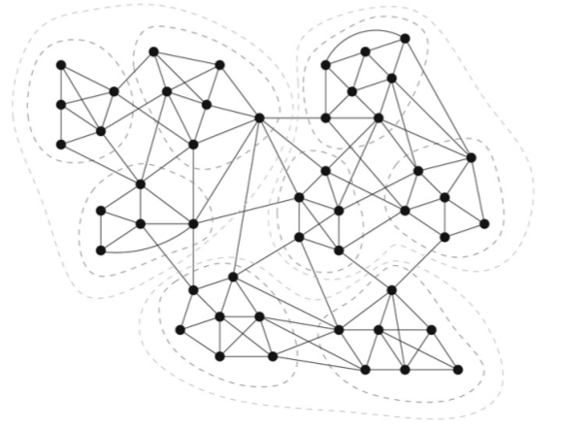
Graph clustering
Data representation:
nodes (objects) and
weighted edges (similarities/ distances between objects)
Transformation
objects characterized by feature vectors can be transformed into a graph representation by using similarities of pairwise objects as edge weights
objects given in a graph representation cannot be converted to a vector representation easily
Many graph clustering algorithms find number of clusters automatically

Slide 50
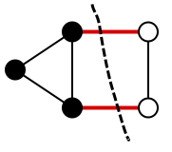
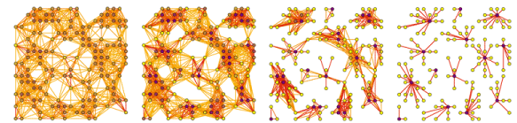
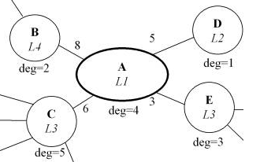
Different approaches to graph clustering
Cut/flow-based
what is the cost of a cut, vs. the benefit in cluster quality?
Random-walk-based
when randomly traversing the graph on its edges, it is likelier to end up in the same cluster
Label propagation-based
copy the label of local friends

Slide 51
MinCut/MaxFlow
MinCut algorithm: hierarchical top-down clustering
compute the minimum cut: leaving out a set of edges, which results in disconnecting a set of nodes from another, with the smallest edge weight sum
recursively apply to the components that got disconnected
Finding the minimum cut is equivalent to finding the maximum flow
advantage
efficient → fastest known algorithm of per-cut complexity O( |E|+log³|V| )
disadvantage
unbalanced cuts
when to stop?
Normalized versions exist that take into account
the size ratio of the components for the cost of a cut

Slide 52
Markov chain clustering (MCL)
Clustering based on random walks
MCL is the parallel simulation of all possible random walks up to a finite length
Idea
a random walker on the graph is more likely to stay within the same cluster than to end up in a different cluster after a small number of steps

Slide 53
Chinese Whispers graph clustering
MCL: keep only a few strong neighbors
Chinese Whispers: only propagate strongest label in neighborhood
nodes have a class and communicate it to their adjacent nodes
a node adopts one of the majority classes in its neighborhood
Biemann, C. (2006): Chinese Whispers - an Efficient Graph Clustering Algorithm
and its Application to Natural Language Processing Problems.
Proceedings of the HLT-NAACL-06 Workshop on Textgraphs-06, New York, USA.
B
L4
D
L2
initialize: forall v_{i} in V: class(v_{i})=i;
while changes:
forall v in V, randomized order:
class(v)=highest ranked class in neighborhood of v;
8
5
deg=2
A
L1
deg=1
3
E
L3
C
L3
6
deg=4
deg=3
deg=5

Slide 54
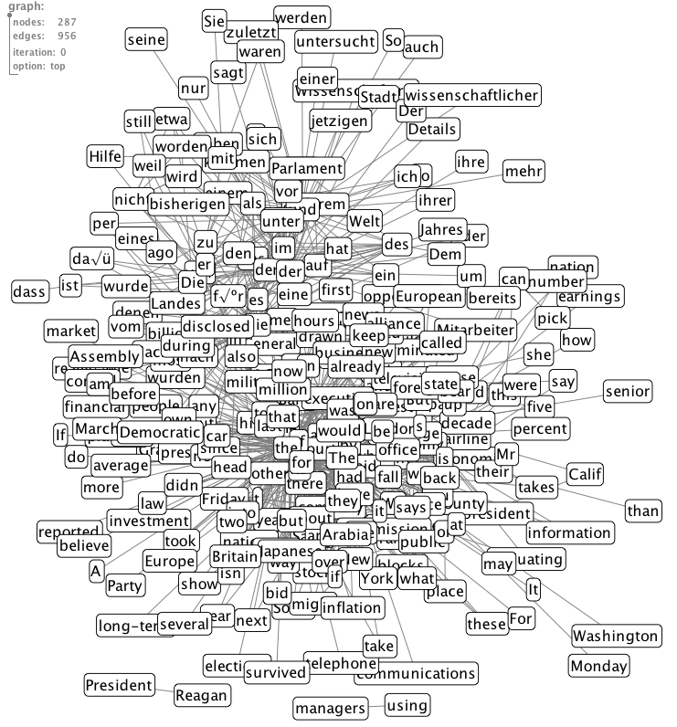
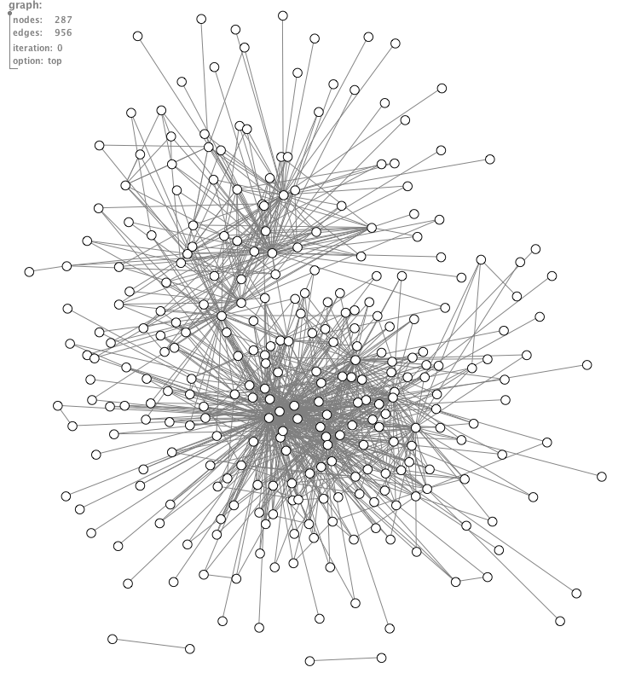
Application: Language separation
Multilingual word co-occurrence graph is connected as some words are used in several languages
Cluster the multilingual word co-occurrence graph and use cluster members to identify sentences/documents belonging to that cluster

Slide 55
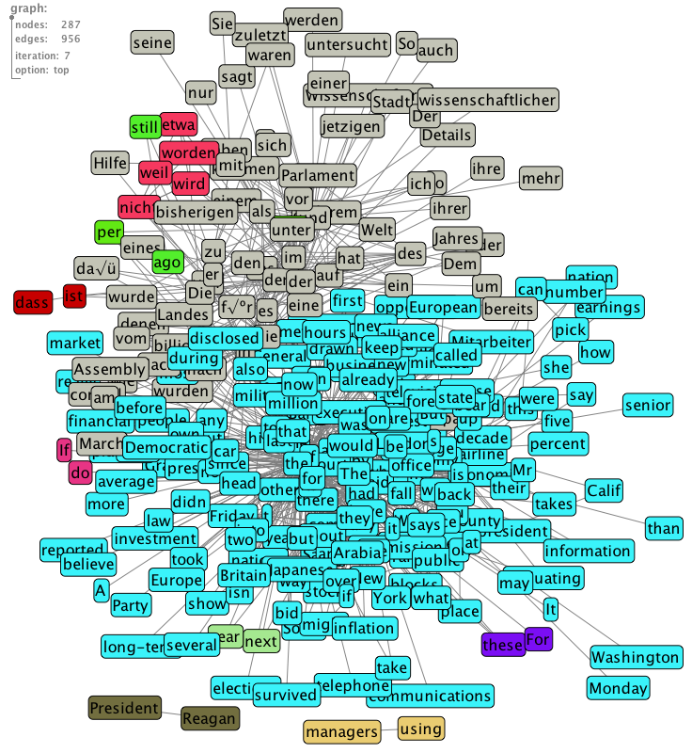
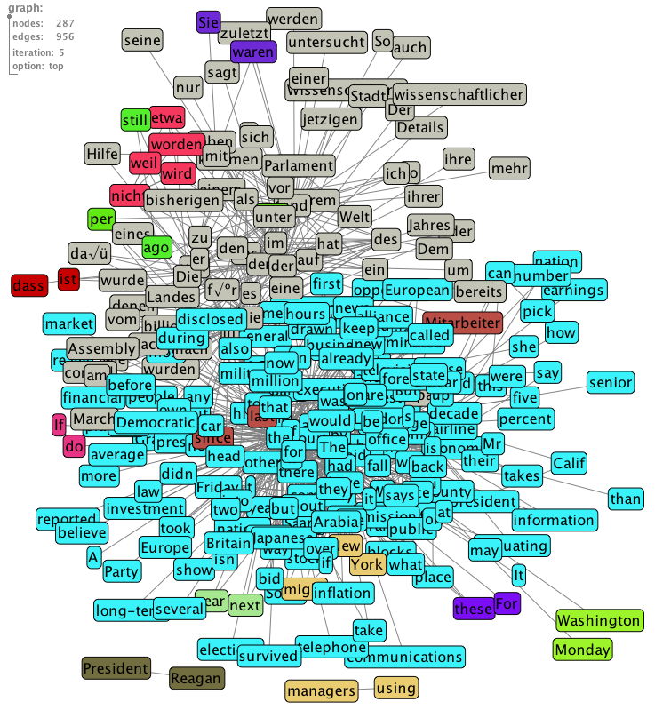
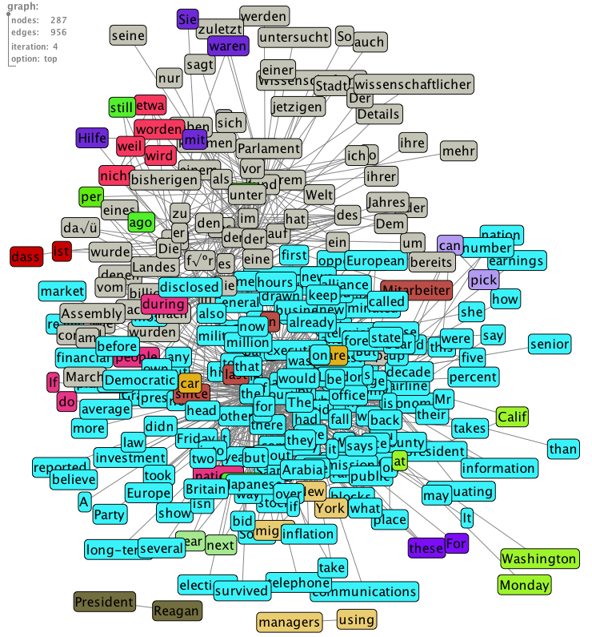
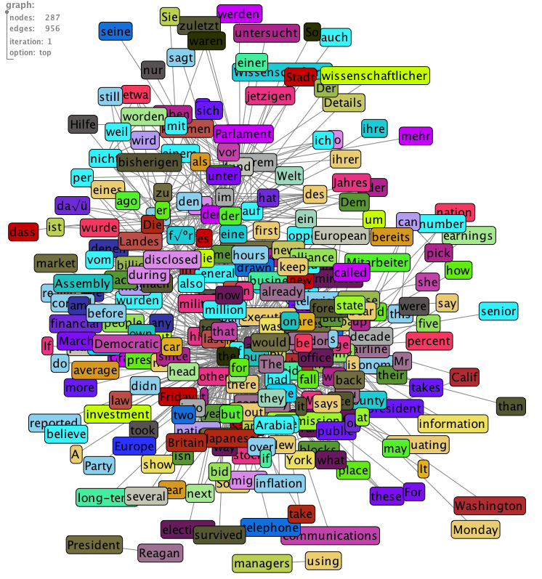
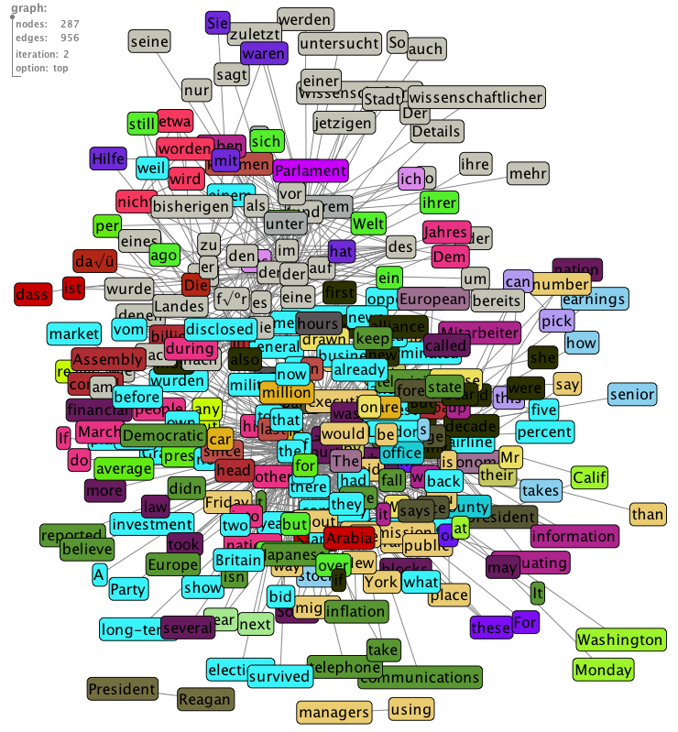
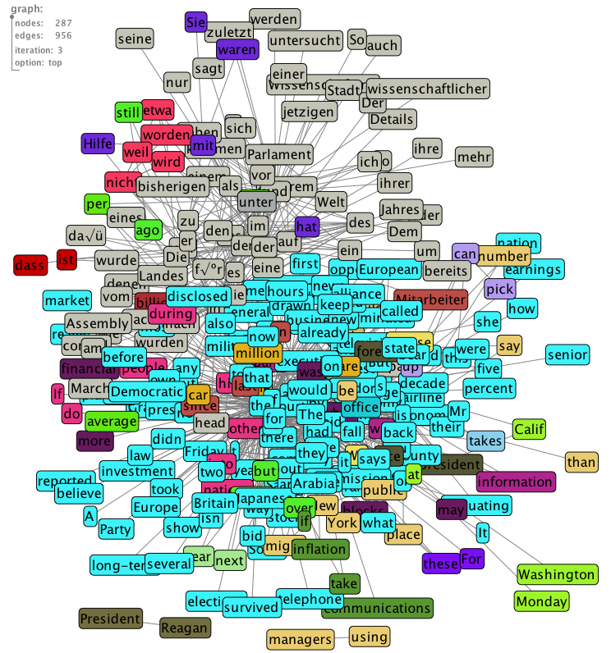
Clustering with Chinese Whispers
Random Initialization
Iteration 1
Iteration 2
Iteration 3
Iteration 4
Iteration 5
Stop

Slide 56
“Look at my nice languages!”
Latin
In expeditionibus tessellata et sectilia pauimenta circumferebat
Britanniam petiuit spe margaritarum: earum amplitudinem conferebat et interdum sua manu exigebat
Scripting
@echo @cd $(TLSFDIR);$(CC) $(RTLFLAGS) $(RTL_LWIPFLAGS) -c $(TLSFSRC) …
@echo @cd $(TOOLSDIR);$(CC) $(RTLFLAGS) $(RTL_LWIPFLAGS) -c $(TOOLSSRC) ..
Hungarian
A külügyminiszter a diplomáciai és konzuli képviseletek címjegyzékét és konzuli …
Köztestületek, jogi személyiséggel és helyi jogalkotási jogkörrel.
Esperanto
Por vidi ghin kun internacia kodigho kaj kun kelkaj bildoj kliku tie chi ) La Hispana..
Ne nur pro tio, ke ghi perdigis la vivon de kelk-centmil hispanoj, sed ankau pro ghia efiko..
Human Genome
1 atgacgatga gtacaaacaa ctgcgagagc atgacctcgt acttcaccaa ctcgtacatg 61 ggggcggaca tgcatcatgg gcactacccg ggcaacgggg tcaccgacct ggacgcccag 121 cagatgcacc …
Isoko (Nigeria)
(1) Kọ Ileleikristi a rẹ rọwo inọ Ọghẹnẹ yọ Esanerọvo?
(5) Kọ Jesu o whu evaọ uruwhere?

Slide 57

Properties of Chinese Whispers
Advantages
efficiency: CW is time-linear in the number of edges
this is bound by n² with n = number of nodes, but in real world data, graphs are much sparser
parameter-free: this includes number of clusters
Disadvantages
non-deterministic: due to random order processing and possible ties w.r.t. the majority
may not converge → see bowtie tie example
The disadvantages are usually not severe for NL data

Slide 58
Outline
Clustering
k-means clustering
Graph clustering
Reinforcement Learning
Notes:
58

Slide 59

Recent Examples of in Reinforcement Learning
The pancake flipping robot

Slide 60

Reinforcement Learning
Learning by interacting with your environment.
https://images.contentful.com/6m9bd13t776q/6ErMnXakpimYOMcUI02YY0/498b44585d4c374aa57c662138f3739f/baby-walking-shoes-desktop.jpg?q=75

Slide 61
Real-world learning
Learning to interact with your environment
https://blog.bschwind.com/2016/05/29/sending-infrared-commands-from-a-raspberry-pi-without-lirc/
Notes:
Klimaanlage: some actions lead to rewards, others have no observable effect

Slide 62
Real-world learning
Learning to interact with your environment
https://2.bp.blogspot.com/-ShIIpT0yex8/VGh5po95srI/AAAAAAAAFl0/FBHI5OqNGNE/s1600/japan-toilet-control-1024x576.jpg
Notes:
Direktes Feedback

Slide 63
Real-world learning
Learning to interact with your environment
http://extravaganzafreetour.com/wp-content/uploads/2017/06/P1170545-1024x768.jpg
Notes:
Delayed Reward: wird man kontrolliert oder nicht?

Slide 64
Real-world learning
Learning to interact with your environment
https://data.motor-talk.de/data/galleries/0/425/7581/71921748/39590923-1673168346633366986.jpg
Notes:
alle sollten sich an bekannte Regeln halten (rechts vor links, rule-based) + gelernte Strategien (wenn der andere Fahrer einen reinwinkt, kann man fahren obwohl es gegen die Regel ist.)

Slide 65

Real-world learning
Learning to interact with your environment
Notes:
soziale Regeln

Slide 66
Real-world learning
Learning to interact with your environment
Notes:
soziale Regeln – können sich ändern, dann muss der Agent sich anpassen

Slide 67

Reinforcement Learning
Learning by interacting with your environment.
http://3.bp.blogspot.com/_1fjMGlWo2xc/TIpubgHQIKI/AAAAAAAAAO8/vXQiCFtbgbk/s400/mouse+maze.jpg

Slide 68
Types of Machine Learning
Machine Learning
Supervised ML
Unsupervised ML
Reinforcement Learning
Notes:
in supervised ML: infeasible to create eg all chess positions as feature vectors an asisgna value to them, better learn from own experience
in unsupervised ML. no feedback whatsoever

Slide 69

Reinforcement Learning: Interaction with the environment
Sutton & Barto: Reinforcement Learning

Slide 70

Reinforcement Learning: Core Concepts
Action a_{t}: what the agent does at a certain timestep t, e.g., move forward or turn left
State s_{t}: representation of the current environment at timestep t, e.g., position in the maze
Reward r_{t}: numerical, received based on an action in a certain state at time t, e.g., -0.1 (no cheese) vs 1 (cheese)
Policy $π$: a strategy telling us which action to take in each possible state:
e.g. for square 1 in the maze: P(turn left) = 0.5
P(turn right) = 0.25
P(walk straight) 0.25
Overall goal: Find a policy $π$which maximizes the total reward, e.g. get the cheese as quickly as possible

Slide 71

Exploration vs. Exploitation
You are standing in front of a number of slot machines („one-armed bandits“). Each machine has a fixed probability to hit the jackpot. You have a lot of time to play. For free. What would you do to maximize the money you get?
You keep track of the average outcome for each machine:
exploitation: select a greedy action – choose the machine that promises the highest reward
exploration: select a non-greedy action, to get a better estimate of the other machines
Notes:
Discussion: what would you do?

Slide 72


Trade-off between Exploration and Exploitation
$ε$-greedy strategy: select an action greedily most of the time, but for some fraction $ε$ of all cases, keep exploring

Slide 73
The Gridworld Example
 | A |  | B
 |  |  | B‘
 | A‘
Possible Actions:
right
down
left
up
+5
In state A, all actions lead to A‘
in state B, all actions lead to B‘.
+10
25 states
Rewards:
leave the grid: -1
leave state A: +10
leave state B: +5
otherwise: 0

Slide 74

The Gridworld Example
 | A |  | B
 |  |  | B‘
 | A‘
What are good fields in the grid?
Evaluate a random policy $π$: choose every action with the same probability
Overall expected reward:
R_{t} = r_{t+1} + $γ$r_{t+2} + $γ$² r_{t+3}+...
$γ$: discount parameter, how important is a future reward
+5
+10

Slide 75


The Gridworld Example
3.3 | 8.8 | 4.4 | 5.3 | 1.5
1.5 | 3.0 | 2.3 | 1.9 | 0.5
0.1 | 0.7 | 0.7 | 0.4 | -0.4
-1.0 | -0.4 | -0.4 | -0.6 | -1.2
-1.9 | -1.3 | -1.2 | -1.4 | -2.0
Evaluate a random policy $π$: choose every action with the same probability
Overall reward:
R_{t} = r_{t+1} + $γ$r_{t+2} + $γ$² r_{t+3}+...
$γ$: discount parameter, how important is a future reward
Each cell contains the value function V$π$(s) with the overall expected reward

Slide 76


Solving the gridworld problem
To solve the gridworld problem, we want to find the optimal value function V* for an optimal policy $π$*
$π$* has an optimal action-value function Q*, telling us the value of every action at a given state
$Q^{∗}(s,a)$= $\max_{π}{Q^{π}(s,a)}$
We determine Q* iteratively.
optimal policy $π$*

Slide 77


Q-learning: Solving the gridworld problem
Pseudocode:
Initialize Q(s,a) arbitrarily
Repeat for each episode:
choose a random start state s
Repeat for each step of the episode:
Choose action a from s using an $ε$greedy policy given the current Q
Take action a, observe reward r and next state s‘
Update Q based on observed reward r and future reward pedicted for s‘
Update s to s‘
$$Q\left(s,a\right)=(1−α)Q\left(s,a\right)+a[r+γ\max_{a′}{Q(s^{′}, a^{′})}]$$
$α$: learning rate
$\max_{a′}{Q(s^{′}, a^{′})}$:future reward if we take the best action in the next state
Notes:
More about that in the exercise

Slide 78

Recent Examples of in Reinforcement Learning
October 2015, AlphaGo defeated the European Go champion Fan Hui.
Large databse with moves + reinforcement learning by playing against another version of itself.

Slide 79
AlphaZero
https://deepmind.com/blog/article/alphazero-shedding-new-light-grand-games-chess-shogi-and-go

Slide 80
Recent Examples of in Reinforcement Learning
Robotics: robots learn how to walk
Health Care: Find optimal treatment policies for patients with chronic diseases:
Dialogue systems: Find a good dialogue policy for a chatbot.
Intelligent Tutoring systems: adapt teaching strategy to optimize learning gain
Job shop scheduling: assign tasks to machines

Slide 81

Take-home messages
k-means clustering
Quick, intuitive, and often good results
How to set k?
Sensitive to outliers and noise
Graph clustering, e.g. Chinese Whispers
Efficient
Not deterministic
Reinforcement learning
Learning through interaction with the environment
For problems where it is hard to provide training instances with labels

